Slide 1
Operations (Maths)
Time to operate your computer
Ben Schwarz

Slide 2
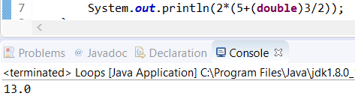
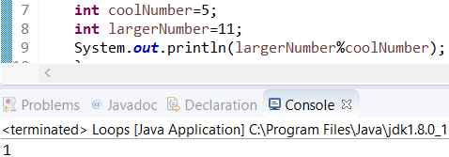
Computers do math(woah)
It is actually quite simple. When executing math java follows BODMAS.
However when doing division and you want a double: You should either place a decimal point and then a digit or put (double) before a number in before the division. This is to make sure that java calculates it as a double. This is second option is known as casting and we will delve into it later. Here is an example:
You can also (and usually
will) use variables. Example:
Remember modulus(%) returns the
remainder

Slide 3

Using the math class
For more complex math you need to use the math class provided by java.
To do this simply type Math. (remember the .) And then type space to see your list of options. Type in what you think it will be called and then hit enter when you find it.
If this Math. thing seems confusing. Don’t worry we will explain later.
Example (which I took from code we used somewhere and placed in an if statement)
Notice that you can declare multiple variable on the same line. You simply need a comma in-between them.

Slide 4
Activities:
Output 5*(8-6/3)%2. Check your answer to make sure it is correct.
Let a user input 2 numbers and find the remainder. (You can ask for the numbers separately).
Write code to input the diameter of a circle and output the area of the circle.
Extension (if you finish the other 3 quickly) Have someone input the hypotenuse of a right angle triangle and a angle(not being the 90) and tell them the other two sides and the opposite angle.
Note: I suggest using Trigonometry. Make sure to read the documentation to understand how to use it and note that java uses radians and not degrees. So you will need to convert (the Math class has a function for this)

